Slide 1


M.Tech/MCA Program
Advanced Industry Integrated Programs
Jointly offered by University and LTIMindTree
Review II
Hybrid Recommendation System for Mobiles
Team Member
Sai Likhitha Bollu
M tech (Artificial Intelligence and Machine Learning)
VIT Vellore
Knowledge partner | Implementation partner

Slide 2
Hybrid Recommendation System for Mobiles
Introduction
Mobile market flooded with choices.
Users face decision-making confusion.
Recommenders simplify product selection.
CF & CB have key limits.
Hybrid model solves major issues.

Slide 3
Hybrid Recommendation System for Mobiles
Objective
Design hybrid mobile recommender system
Combine content-based and collaborative filtering
Generate personalized phone suggestions

Slide 4
Hybrid Recommendation System for Mobiles
Modules Covered
Data Handler
Content-Based Filtering
Collaborative Filtering
Hybrid Recommender

Slide 5
Hybrid Recommendation System for Mobiles
Data Handler
Data Acquisition:
Two datasets from Kaggle merged together.
Challenges:
No user interaction data (views, likes, purchases).
Tried applying for 91mobiles API, but access was denied.
Solution:
Normalized model names and cleaned inconsistencies.
Removed outliers and filled missing values to ensure quality.

Slide 6
Hybrid Recommendation System for Mobiles
Content-Based Filtering
Approach:
Cosine similarity.
Strengths:
Works well even with limited user data.
Highly customizable to user preferences.
Limitations:
Doesn’t consider popularity or user behavior.
Can be too narrow in recommendations.

Slide 7
Hybrid Recommendation System for Mobiles
Collaborative Filtering
Approach:
Applied user-based nearest neighbor and matrix factorization techniques.
Strengths:
Captures trends and popularity.
Can recommend unexpected but relevant items.
Limitations:
Cold start problem for new users or items.
Requires interaction data.

Slide 8
Hybrid Recommendation System for Mobiles
Hybrid Recommender
Strategy:
Combined CBF and CF using a weighted approach:
Content-Based: 70–80%
Collaborative: 20–30%
Benefits:
Balances personalization and popularity.
Reduces limitations of individual models.

Slide 9
Hybrid Recommendation System for Mobiles
Methodology/Modeling Plan
Collaborative Filtering - Matrix Factorization, Nearest Neighbors
Context Based Filtering - Cosine Similarity, Feature Matching
Explainability - LLM-based Justification
Serendipity - Feature Diversity Logic
Contrarian - Inverse Preference Modeling

Slide 10
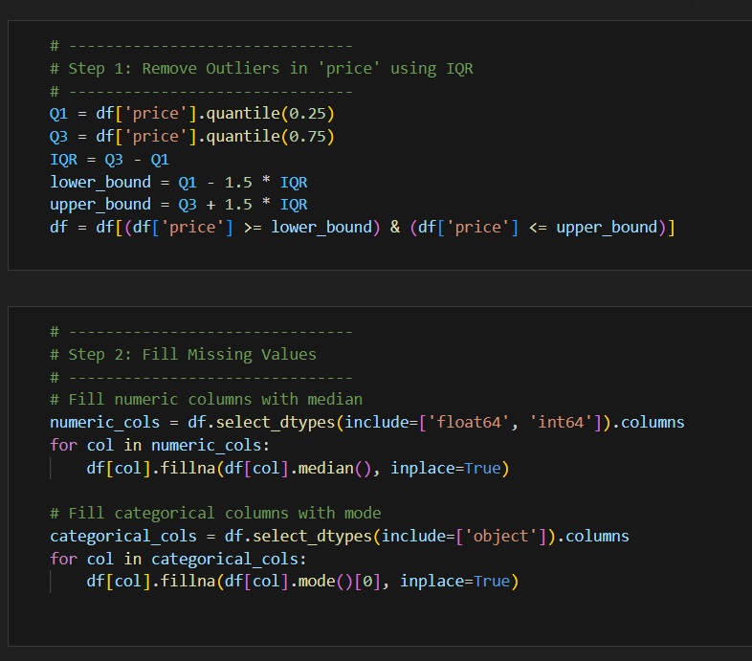
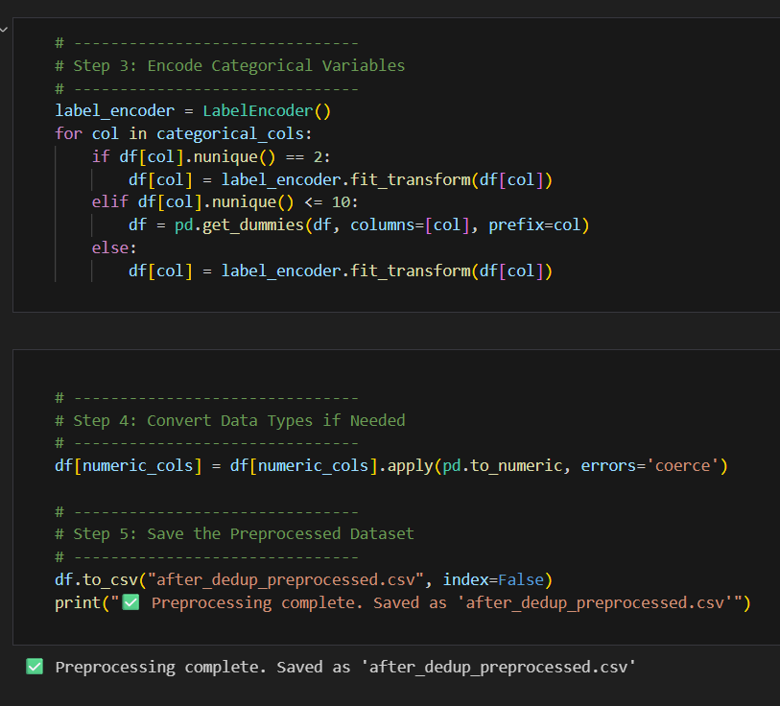
Hybrid Recommendation System for Mobiles
Data preprocessing & EDA

Slide 11
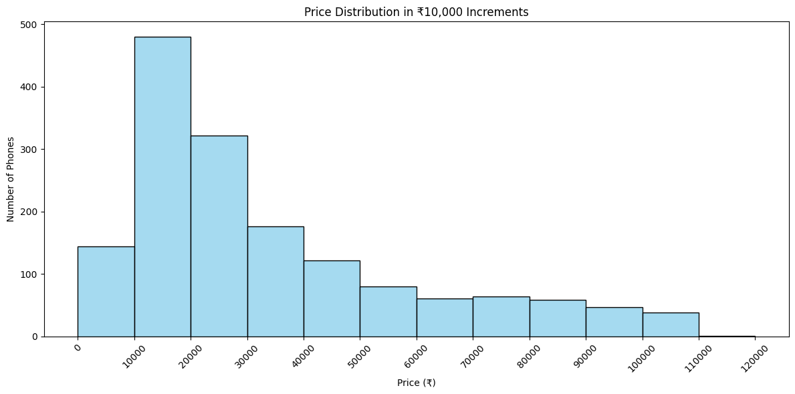
Hybrid Recommendation System for Mobiles
Data preprocessing & EDA

Slide 12
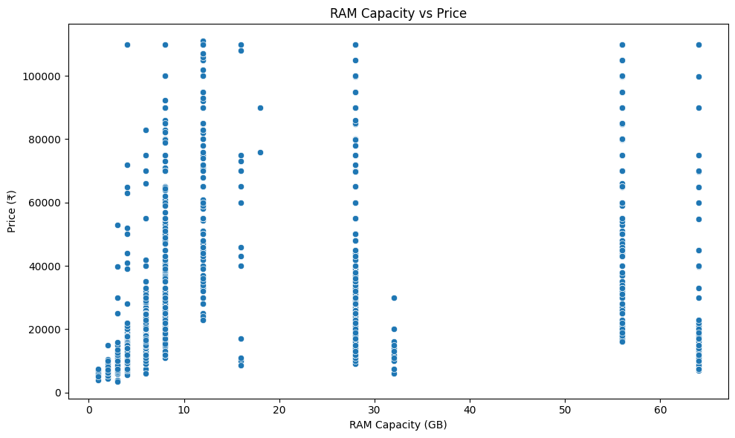
Hybrid Recommendation System for Mobiles
Data preprocessing & EDA

Slide 13
Hybrid Recommendation System for Mobiles
Approach/Algorithms/Tools
Algorithms – Cosine Similarity, Matrix Factorization, KFN
Tools – Python, pandas, scikit-learn, LLMs for explainability
Libraries – Surprise, Matplotlib
Deployment – Streamlit

Slide 14
Modules
Hybrid Recommendation System for Mobiles
Project plan/milestones progress
Completed
Data Handler
Content-Based Filtering
Collaborative Filtering
Hybrid Recommender
To be done
Explainability
Serendipity & Contrarian Logic
User Interface

Slide 15
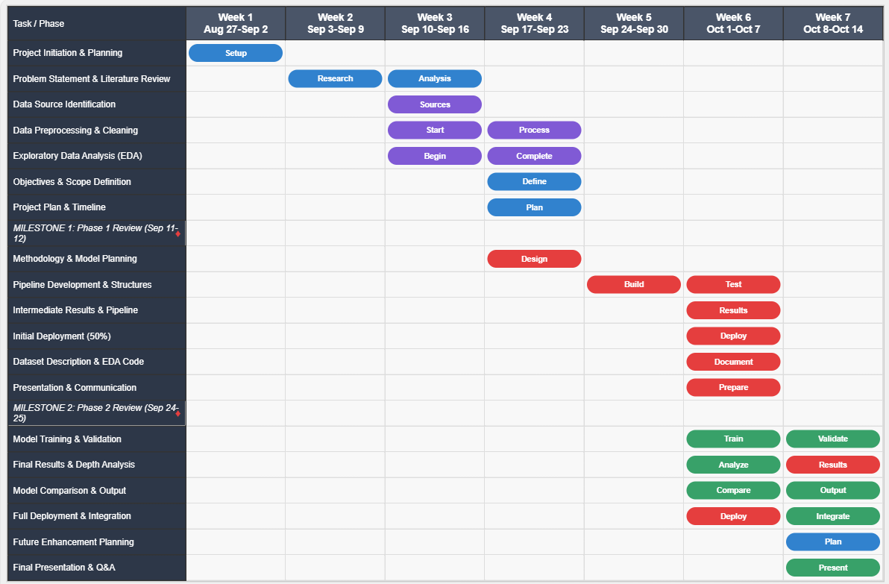
Hybrid Recommendation System for Mobiles
Pipeline structure

